Slide 1
Page 01
P552 MANUFACTURING
Presented by Group-05
ExcelR

Slide 2
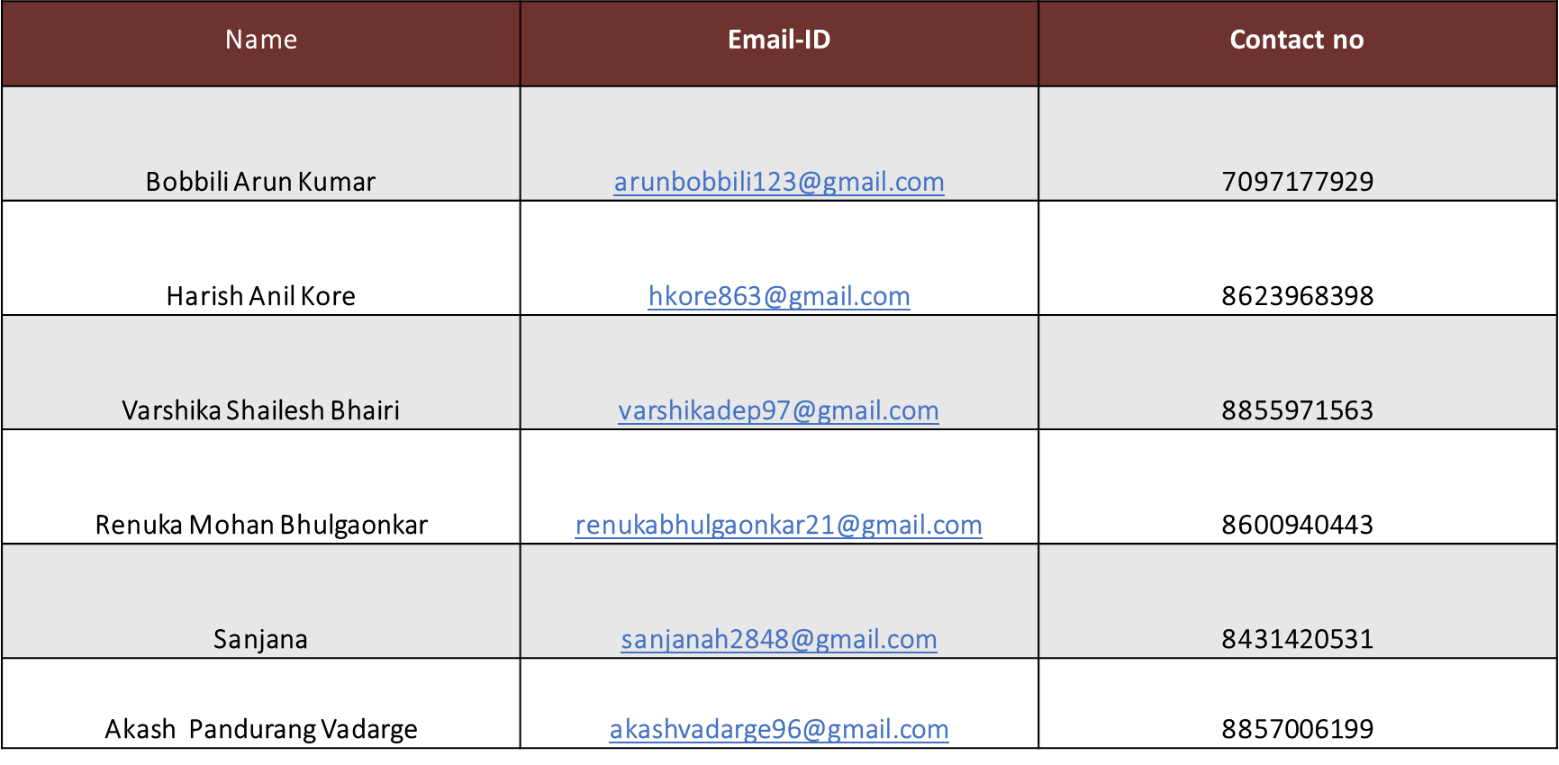
Page 02

Slide 3
Page 03
Overview
Summary
KPI’s
KPI Card
Excel Dashboard
Tableau Dashboard
Overview Page
Power BI
SQL Query
Key Point
Thank You
Implementation
P552 Manufacturing

Slide 4
Page 04
Summary
P552-Manufacturing Analysis involves analyzing the various processes involved in manufacturing a product or part, including materials sourcing, production methods, quality control, and cost analysis.
By examining each stage of the manufacturing process, companies can identify areas for improvement, increase efficiency, and reduce costs. This analysis helps companies optimize their production processes to meet customer demand and maintain a competitive advantage in the market.
Additionally, manufacturing analysis can also help companies identify opportunities for innovation and new product development.
This analysis also focuses on identifying inefficiencies in the production process and finding ways to improve them.
This includes reviewing production data, identifying bottlenecks, evaluating equipment performance, and optimizing workflows. By analyzing manufacturing processes, companies can increase productivity, reduce costs, and improve overall efficiency.
Through continuous monitoring and analysis, businesses can make data-driven decisions to enhance their manufacturing operations and stay competitive in the market.
P552 Manufacturing

Slide 5

Page 05
KPI’s
1.Manufacture Qty
2.Ttl Rejected Qty
2.Processed Qty
3.Wastage Qty.
4.Employee Wise Rejected Qty.
5.Machine Wise Rejected Qty.
6.Production Comparison trend.
7.Manufacture Vs Rejected.
8.Department Wise Manufacture Vs Rejected.
10.total under Production Qty.
12.no of customers(Distinct Customers)
13.top 5 buyers. in Percentage.
14.dashboard Design.
P552 Manufacturing

Slide 6
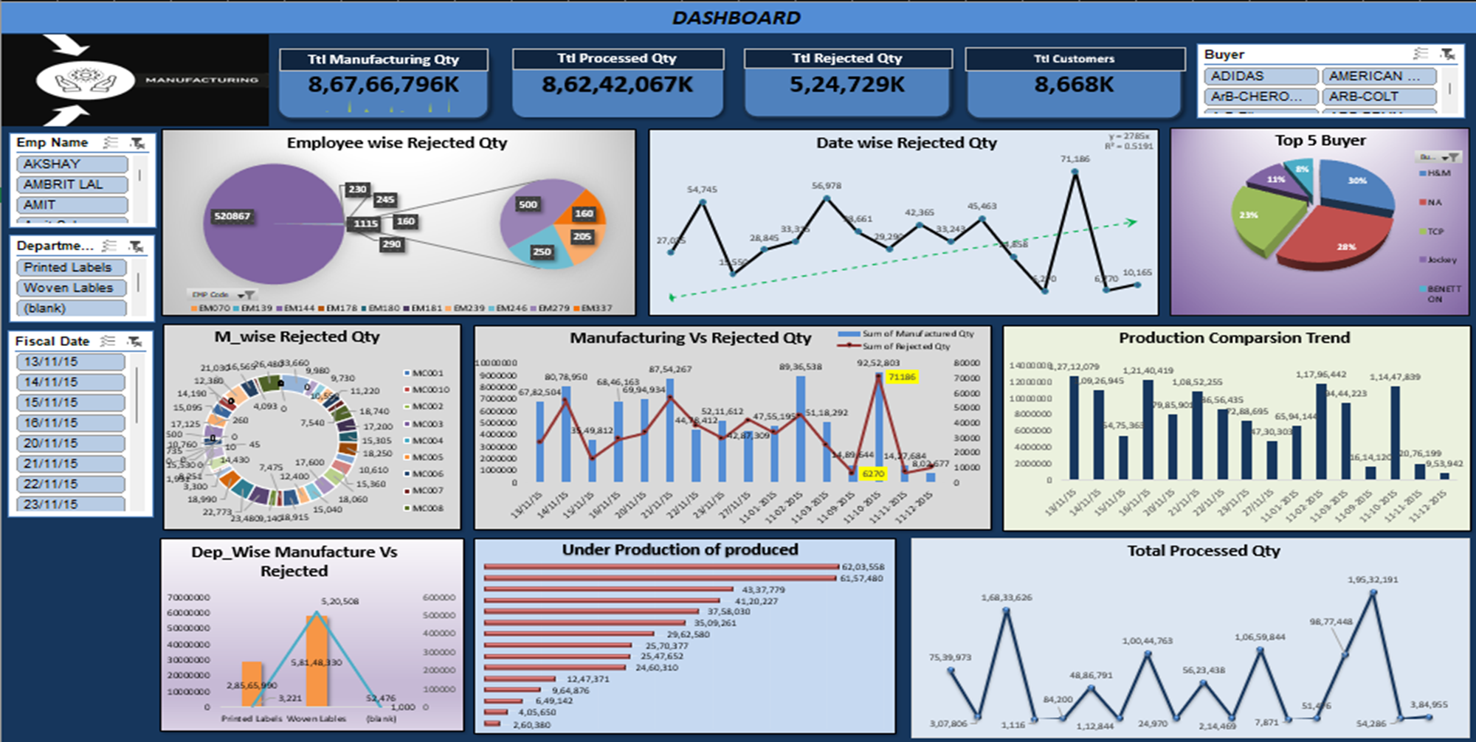
Page 06
Excel

Slide 7
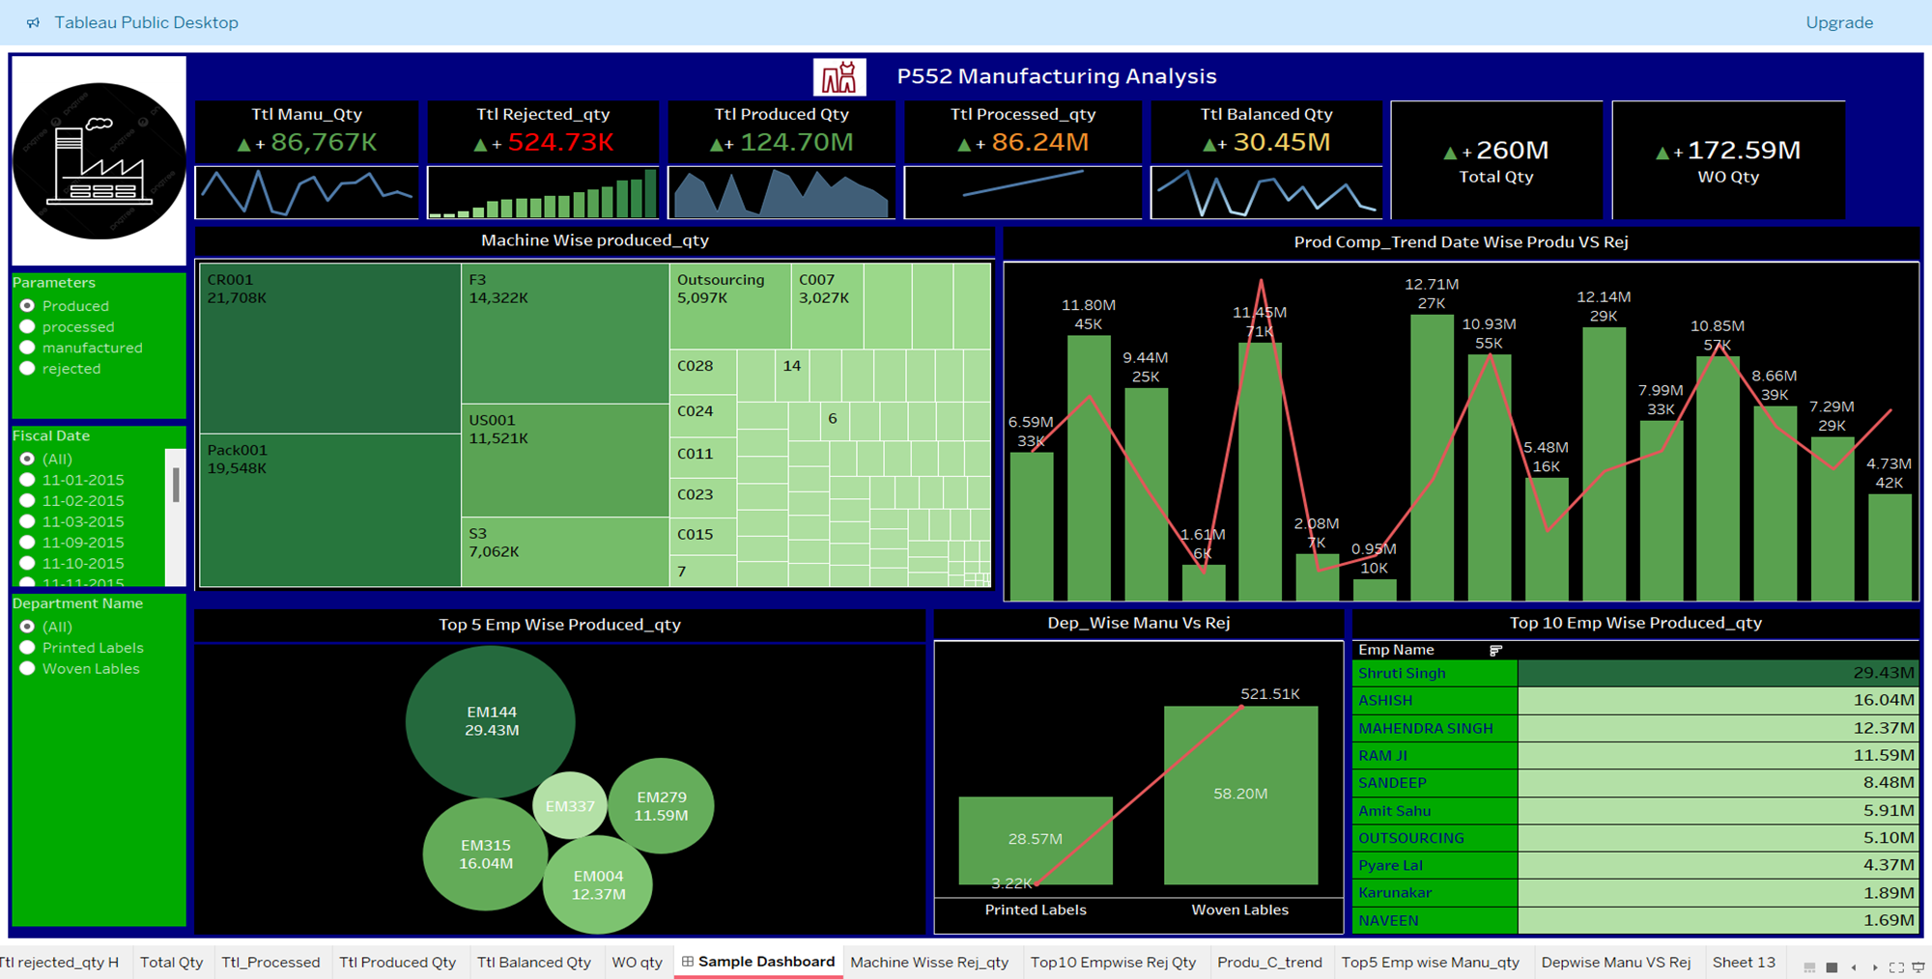
Page 07
Tableau

Slide 8
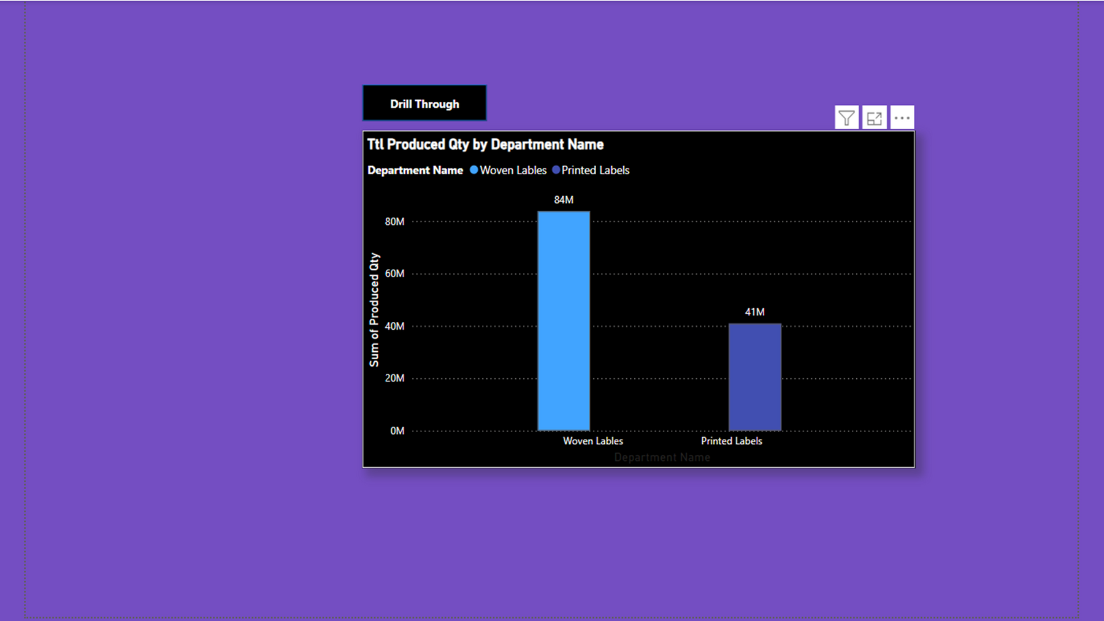
Page 08
Overview Page

Slide 9
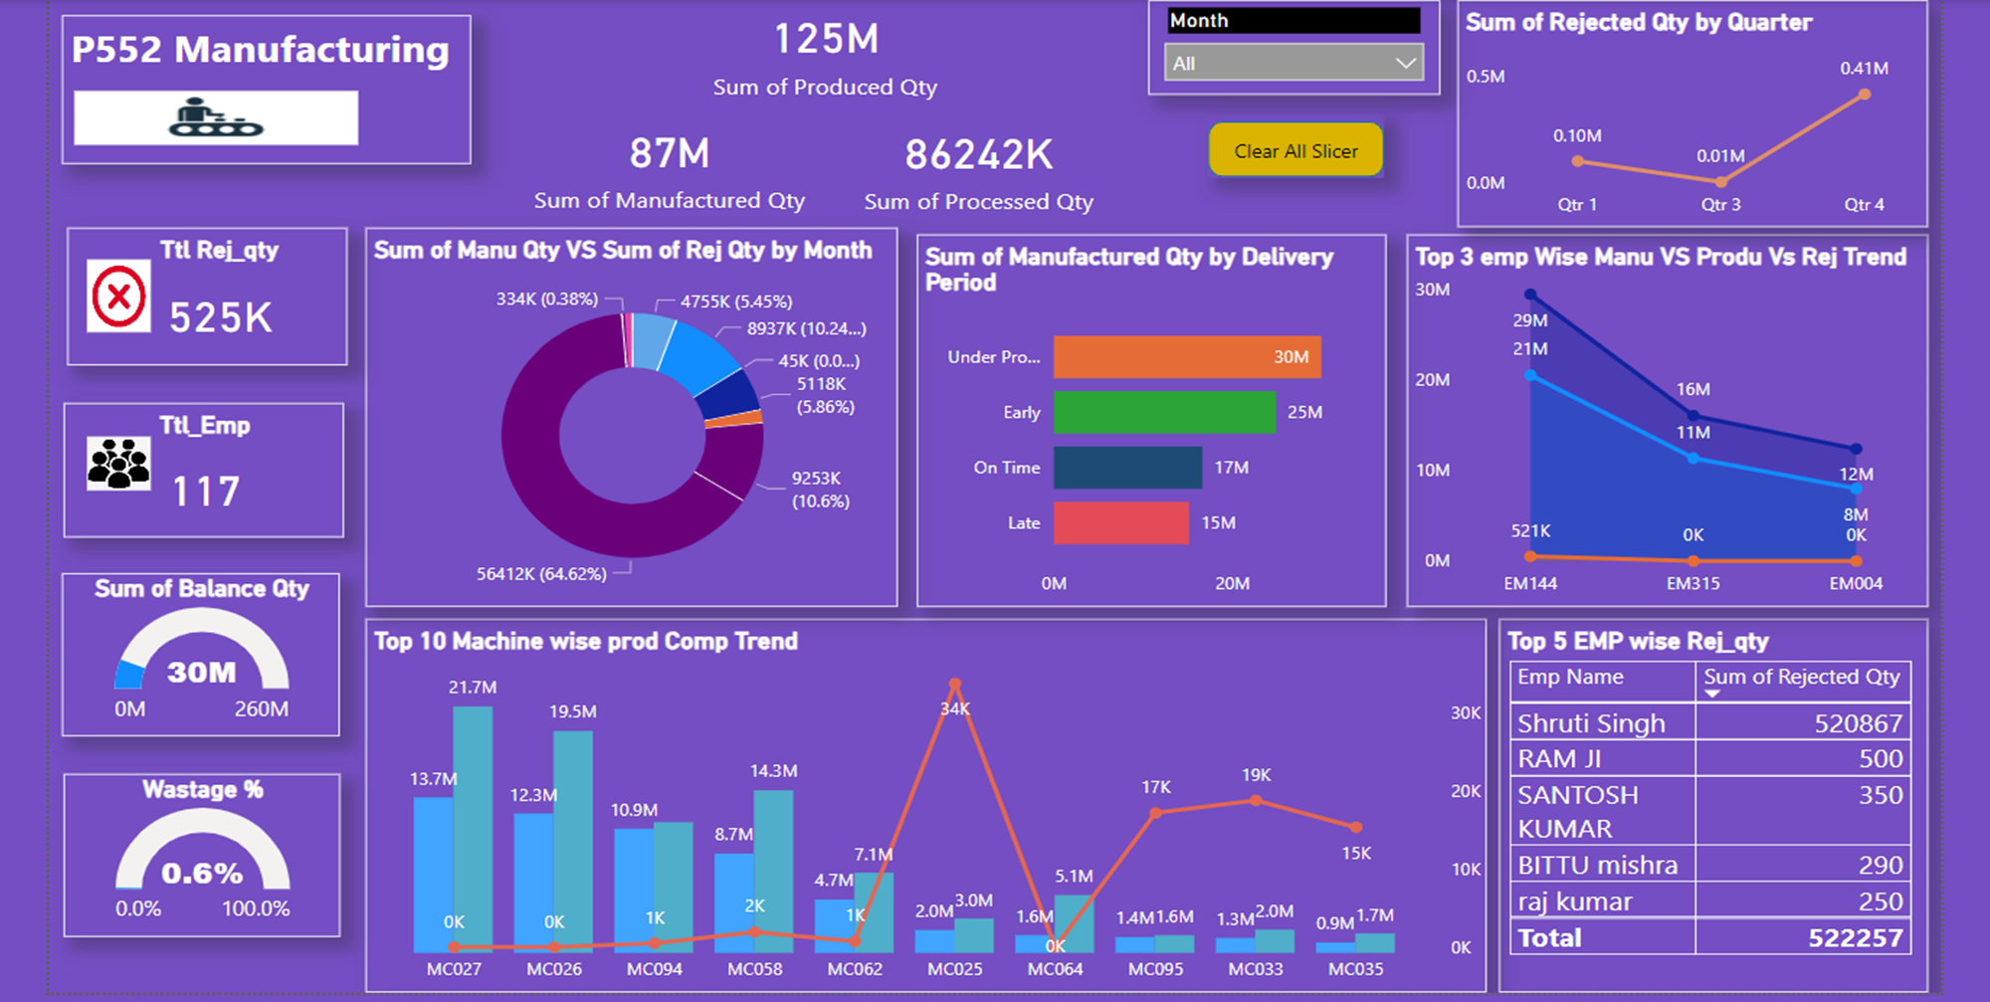
Page 09
Power BI

Slide 10
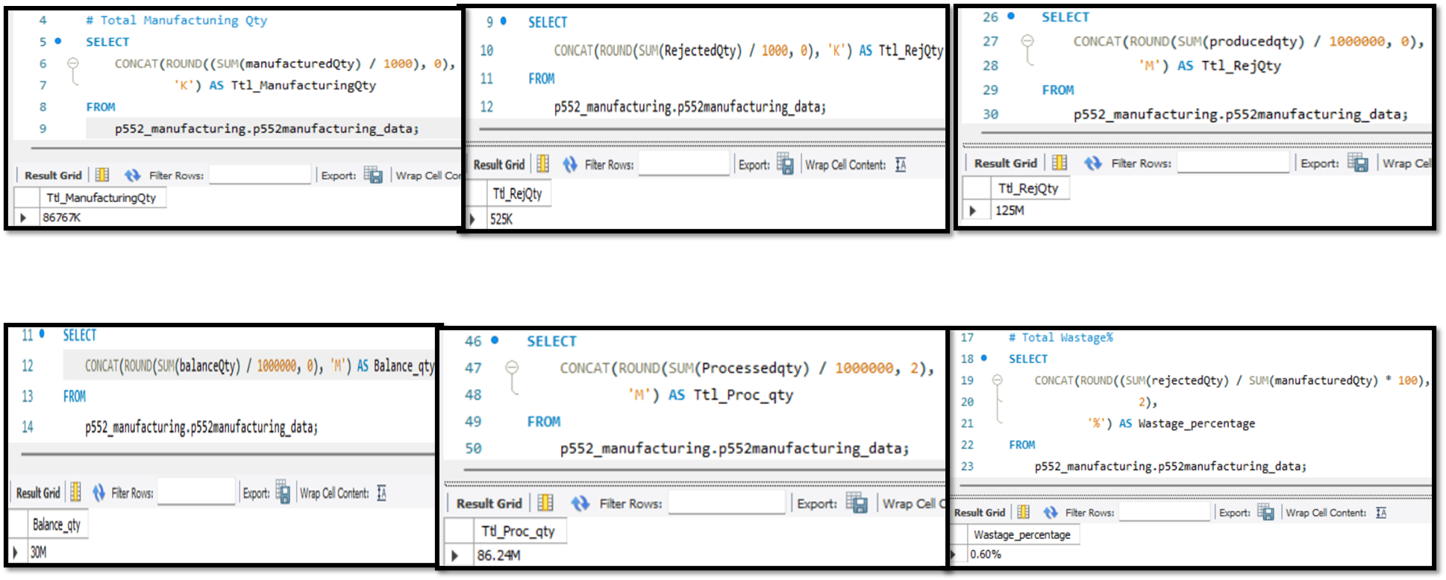
Page 10
MySQL

Slide 11
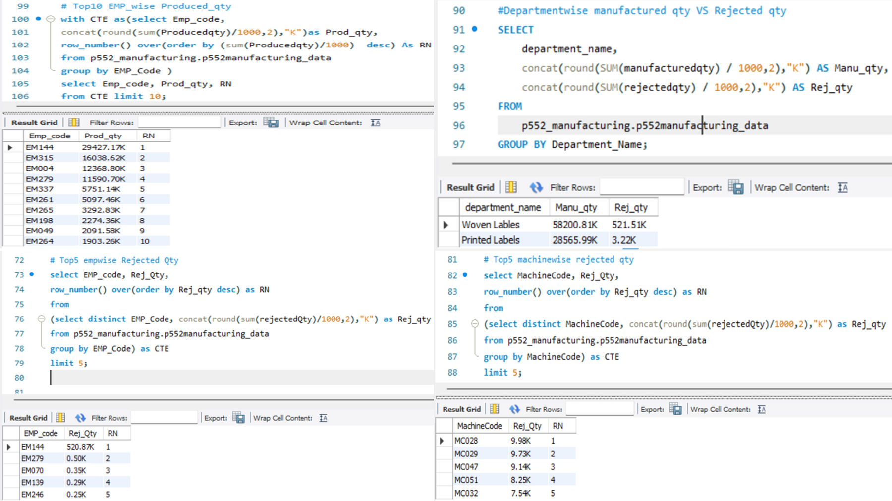
Page 11
MySQL

Slide 12
Page 12
Key Points
Through this analysis we can conclude that H&M has been the highest buyer with 71M of quantity produced.
Quarter 4 has been the more economic quarter with highest production and Quarter 3 been the least produced quarter.
Optimization of machine settings to reduce defects and increase yield in the machines(like MC025).Implementation of quality control measures to detect and address issues earlier in the process.
Improvement of material handling employees and storage procedures machines to reduce waste and increase efficiency.
Enhancement of operator training programs for the employees to ensure consistent and high-quality production.
Investigation into alternative materials or suppliers to reduce costs and improve quality.
P552 Manufacturing

Slide 13
THANK
YOU
Group-05 | P552 Manufacturing
ExcelR

